Slide 1
中国改革开放历程和成果、经验和启示
China's Reform and its Enlightenment
中国驻利比里亚大使任义生
Chinese Ambassador to Liberia H.E. Ren Yihsneg
25 May 2022

Slide 2

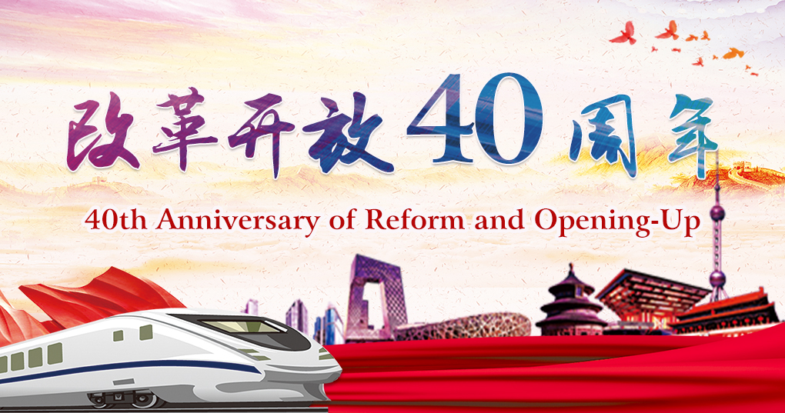

Slide 3
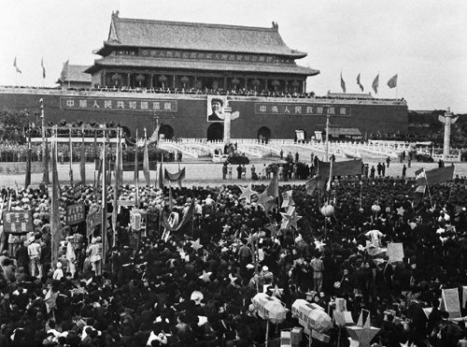
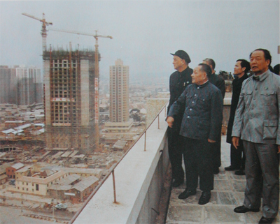
I. The course and main achievements of China's reform and opening-up

Slide 4
Four stages of China's Reform and Opening-up
The first stage was from 1978 to 1992, clarifying the reform goal of establishing a socialist market economic system.
The second stage was from the 14th National Congress of the CPC in 1992 to the 16th National Congress of the CPC in 2002, initially establishing the socialist market economic system framework.
The third stage was from the 16th National Congress of the CPC in 2002 to the 18th National Congress of the CPC in 2012, deepening the reform of the economic system and continuously improving the socialist market economic system.
The fourth stage is since the 18th National Congress of the CPC in 2012, China's reform has entered a new stage

Slide 5
First stage: the initiation and target
exploration stage of reform and opening-up
Reforms first started in rural areas;
Gradually advanced to cities;
State-owned enterprises began to carry out pilot projects to expand their autonomy;
Individual economy was gradually restored and developed

Slide 6
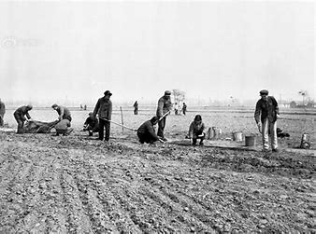

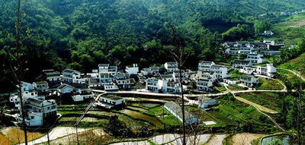
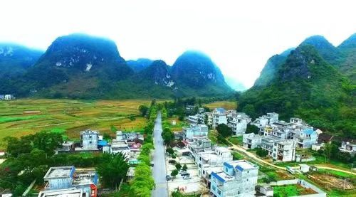

Slide 7
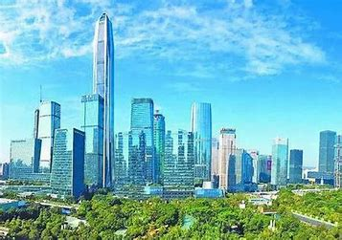
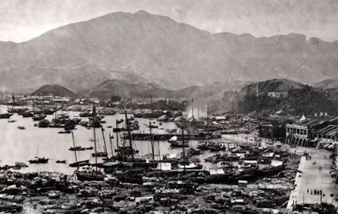
Shenzhen SEZ, yesterday and today

Slide 8
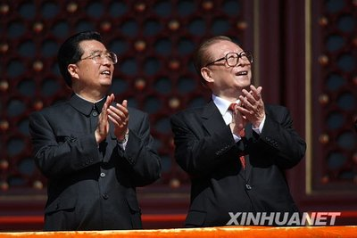
Second stage: from the 14th National Congress
of the CPC in 1992 to the 16th National Congress
of the CPC in 2002

Slide 9
Initially establish the socialist market economic system framework
Establish the basic economic system with public ownership as the main body and the joint development of various economies
Reform of state-owned enterprises

Slide 10
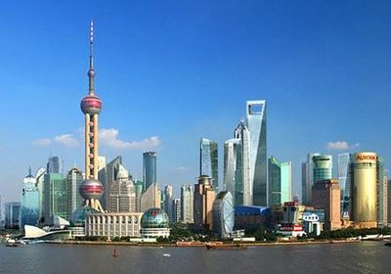
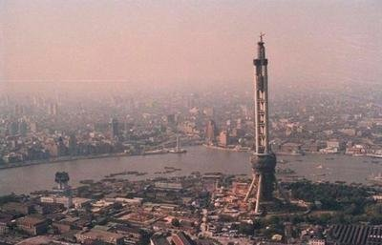
Shanghai, yesterday and today

Slide 11
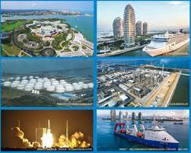
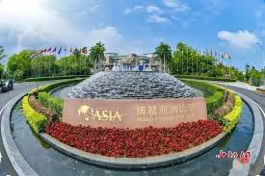
HAINAN SEZ, FTP, BOAO Forum for Asia, WENCHANG SPACECRAFT LAUNCH SITE

Slide 12
Third Stage: further improving the socialist market economic system from 2003 to 2011
market access for the non-public economy was further relaxed, and state-owned commercial banks began to carry out shareholding reform
The investment autonomy of enterprises gradually expanded,
Other factor markets such as land, labor, technology, property rights,
Capital have been further developed,
Agricultural tax, animal husbandry tax, special product tax and so on abolished

Slide 13
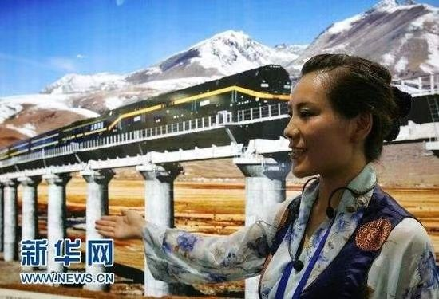
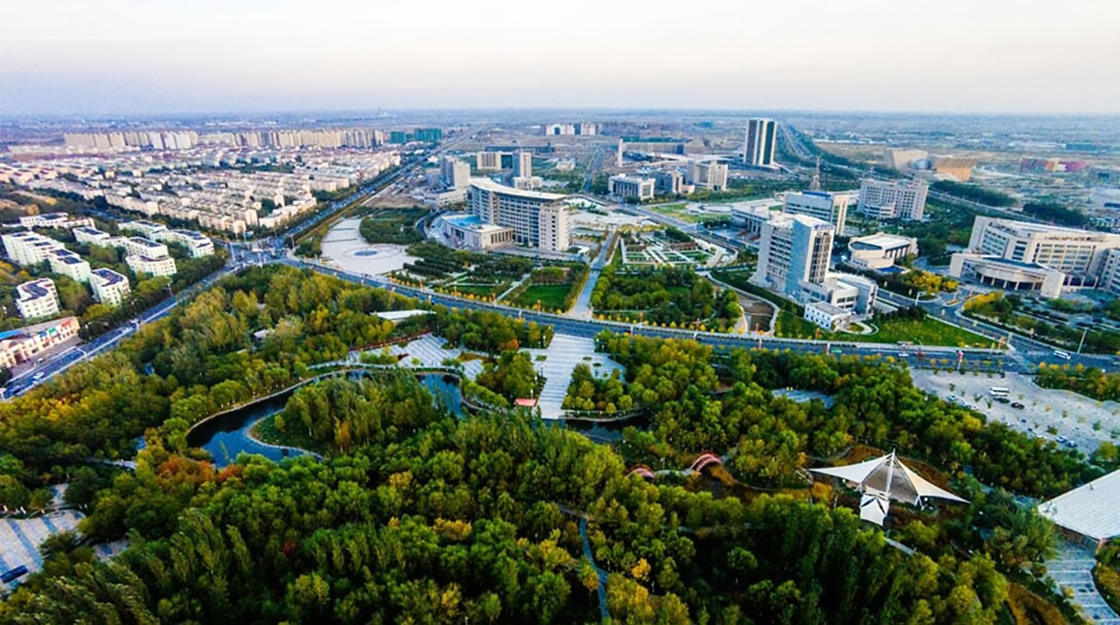
QINGHAI-TIBET RAILWAY
Beautiful XINJIANG

Slide 14
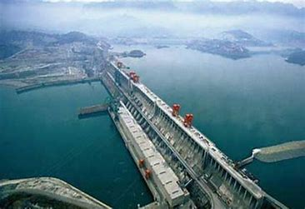
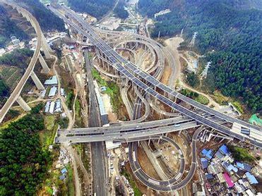
Three Gorges Dam
Overpass Bridge in Guizhou

Slide 15
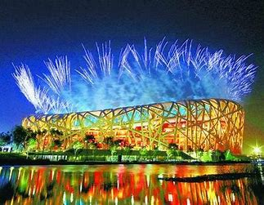
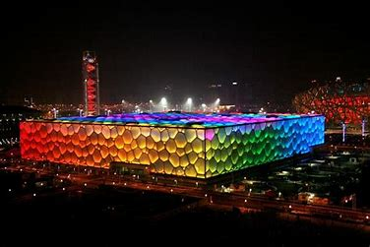
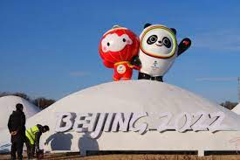
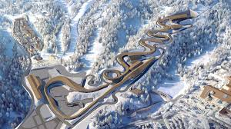
One World
One Family

Slide 16
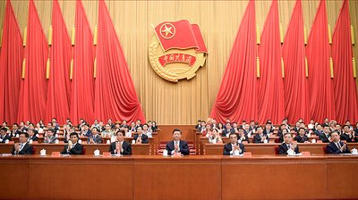
The Fourth stage: a new stage of comprehensively deepening the reform from 2012 till today

Slide 17
Improve and develop socialism with Chinese characteristics, and to promote the modernization of the state governance system and capacity
Shift from focusing on the reform of the economic system in the past to comprehensively deepening the reform, which is a multi-faceted reform of the economic, political, cultural, social, and ecological civilization systems

Slide 18
A series of major reforms of the party and state institutions
The administrative management system,
The rule of law system, the judicial system,
The foreign affairs system,
The social governance system,
The ecological environment supervision system,
National security system, national defense and army,
The party's leadership and party building system,
And the discipline inspection and supervision system have been steadily advanced

Slide 19
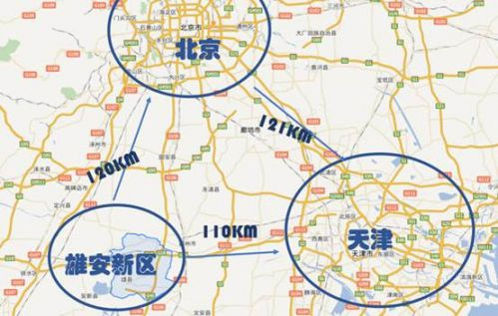
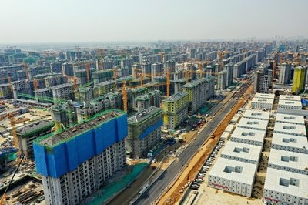
Xiong-an New Area, a millennium strategy

Slide 20


Slide 21
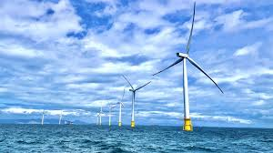
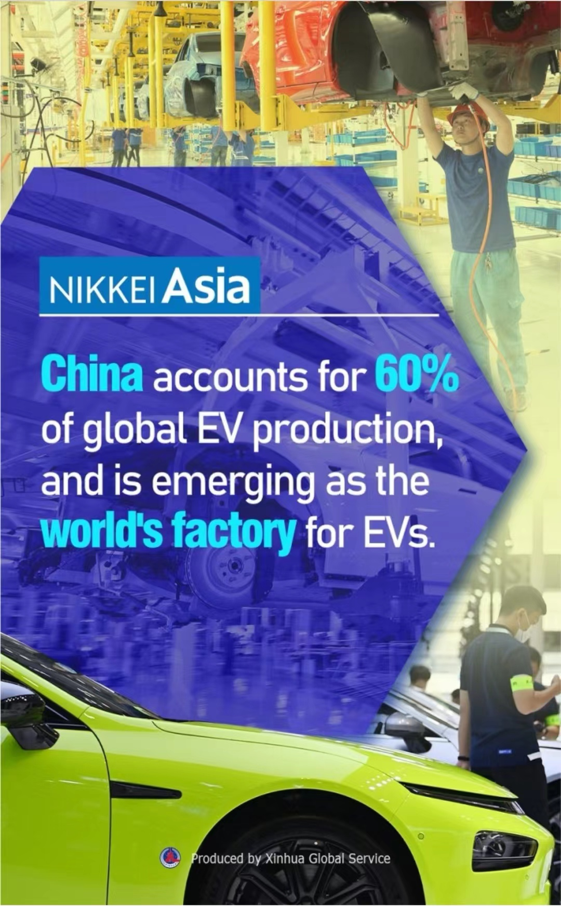
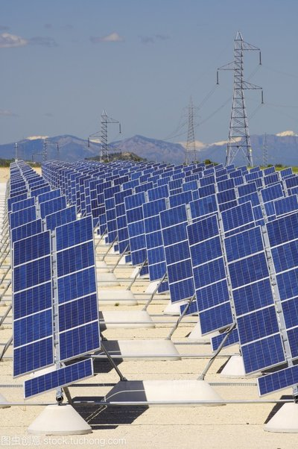
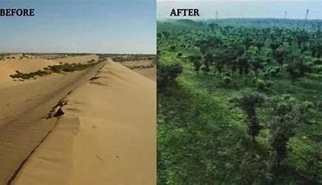
Green development

Slide 22
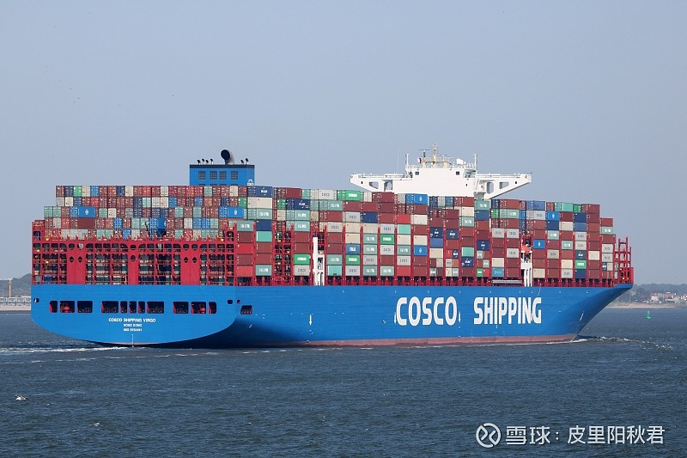
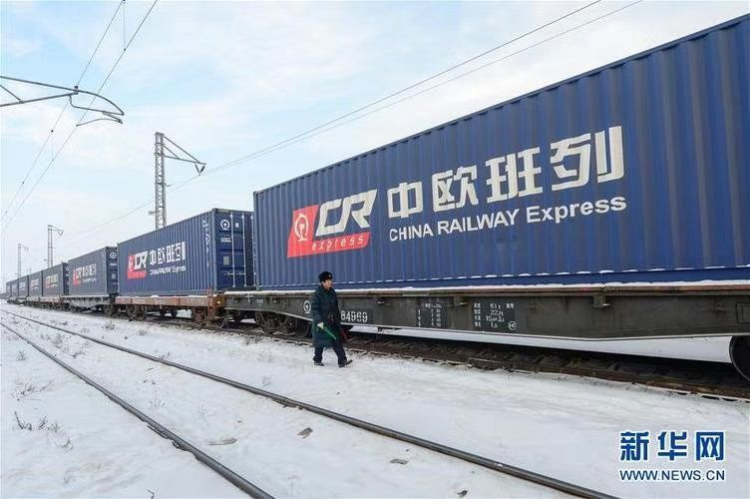
BRI, GDI, GSI

Slide 23
Major achievements of China's reform and opening-up
Rapid economic development,
Rapid changes in urban and rural areas,
Great improvement in people's livelihood,
Increasing national comprehensive strength,
Unprecedented improvement of international status

Slide 24
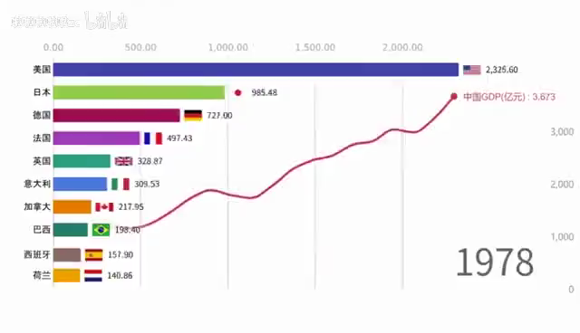

Comprehensive Economic Strength
GDP
Per Capita GDP
World No. 68
World No. 2
World No. 11
World No. 121

Slide 25
Comprehensive Economic Strength
Manufacturing value-added
Goods Trade
Foreign Exchange Reserves
World No. 1 for 5 consecutive years
World No.1
World No.24
World No.83

Slide 26
Comprehensive Economic Strength
Food Production
Urbanization Level
People's Happiness Index
600kg
per capita
300kg
per capita

Slide 27
Party and State Institutional Reform
Special Economic Zone
Sea-shore,River-shore,Border-shore,along-railway Opening-up
Reform of administrative system
Inland Major City Opening-up
Reform of the system of rule of law
Political System Reform
“Bring In”
Expanding foreign finance access
Reform of the judicial system
Reform of Foreign Affairs System
China's Reform and Opening-up
Strengthen the protection of intellectual property rights
Reform
Opening-up
Reform of social governance system
Increasing imports of goods and services
Reform of the ecological and environmental inspection system
Rural Agricultural Reform
“Go Out”
Accession to WTO
Reform of the national security system
Economic System Reform
Ownership Reform
Building "Belt&Road" together
Defense and military reform
Household contracting
Separation of "three rights" of contracted land
Modern Enterprise System
Free Trade Pilot Zone
Reform of the Party leadership and the party building system
The emergence of township enterprises
Free Trade Port
Winning the battle against poverty
Socialist Market Economy
China International Import Expo
Abolition of taxes on agriculture and animal husbandry and special products
Reform of the discipline inspection and supervision system
Comprehensive Deepening
Implementation of rural revitalization strategy

Slide 28

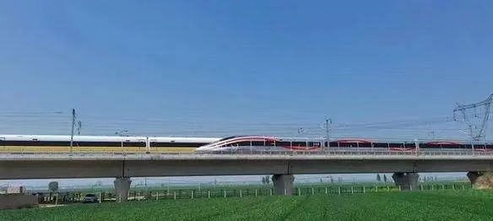
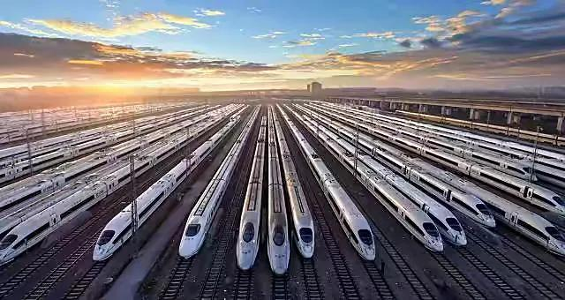
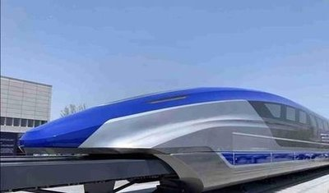

Slide 29
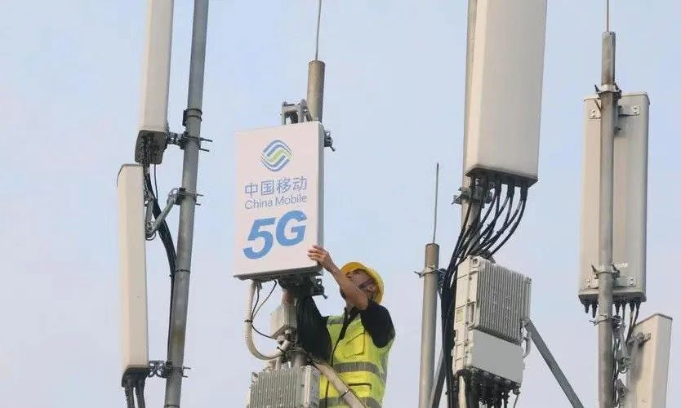
16M SHIELD MACHINE
2,000,000 5G BASE STATIONS

Slide 30
II.The successful experience and enlightenment of China's reform and opening-up
The first is to adhere to the centralized and unified leadership of the Party over reform；
The second is to adhere to the people-centered philosophy；
The third is to mobilize all positive factors；
The fourth is to firmly seize the focus of reform；
The fifth is to emancipate the mind and encourage exploration。

Slide 31
II.The successful experience and enlightenment of China's reform and opening-up(continued)
The third, to mobilize all positive factors
Proved during Chinese revolution, construction and reform;
Mobilize enthusiasm of farmers through the household contract responsibility system;
Mobilize enthusiasm of enterprises through deepening the enterprise reform and implementing the shareholding system;
Mobilize the enthusiasm of all strata through the implementation of the market economy

Slide 32
II.The successful experience and enlightenment of China's reform and opening-up(continued)
The fourth, firmly seize the focus of reform
From 1978 to 1992, clarifying the reform goal of establishing a socialist market economic system;
From1992 to 2002, initially establishing the socialist market economic system framework;
From 2002 to 2012, deepening the reform of the economic system and continuously improving the socialist market economic system;
Since 2012 , China's reform has entered a new stage, and the overall goal of comprehensively deepening the reform has been proposed

Slide 33
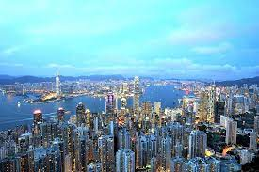
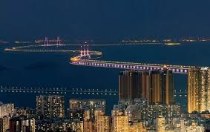
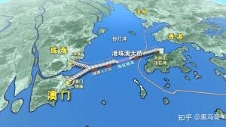
Guangdong, Hong Kong, Marco Greater Bay Area Cooperation

Slide 34
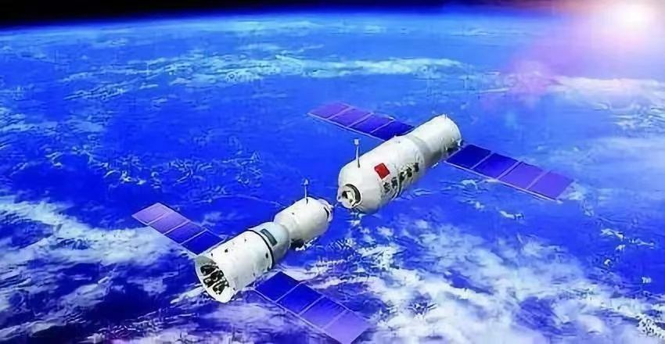
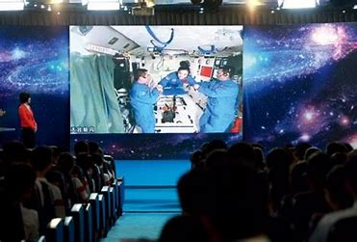

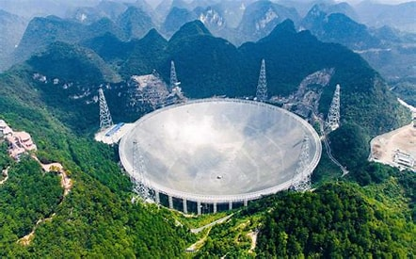
Space exploration
deep-sea manned submersible (10,000 meters)
The Five-hundred-meter Aperture Spherical radio Telescope (FAST)

Slide 35

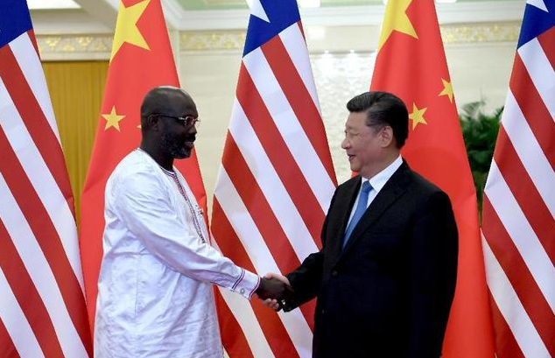
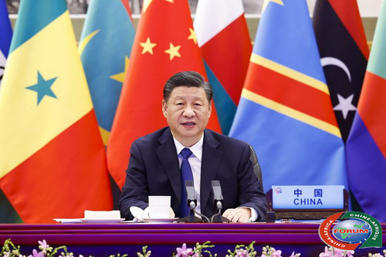

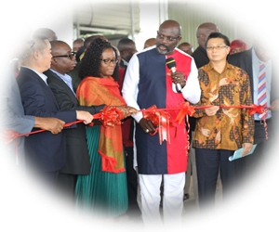
III. Strengthen the exchange of experience in state governance, and carry out mutually beneficial and friendly cooperation between China and Liberia

Slide 36
What to do...
Steadily advance pragmatic cooperation in the fields of economy and trade, infrastructure construction, agriculture, education, people-to-people exchanges, and public health
Dock the Belt and Road Initiative (BRI) and the Pro-Poverty Agenda for Prosperity and Development (PAPD)
Implemente Nine Programs under FOCAC;
Uphold the principles of sincerity, real results, amity and good faith and the concept of pursuing the greater good and shared interests;
Exchange expericence in state governance, economic reform, poverty reduction and fighting corruption

Slide 37
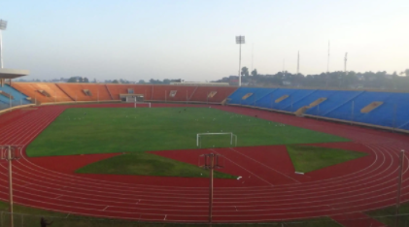
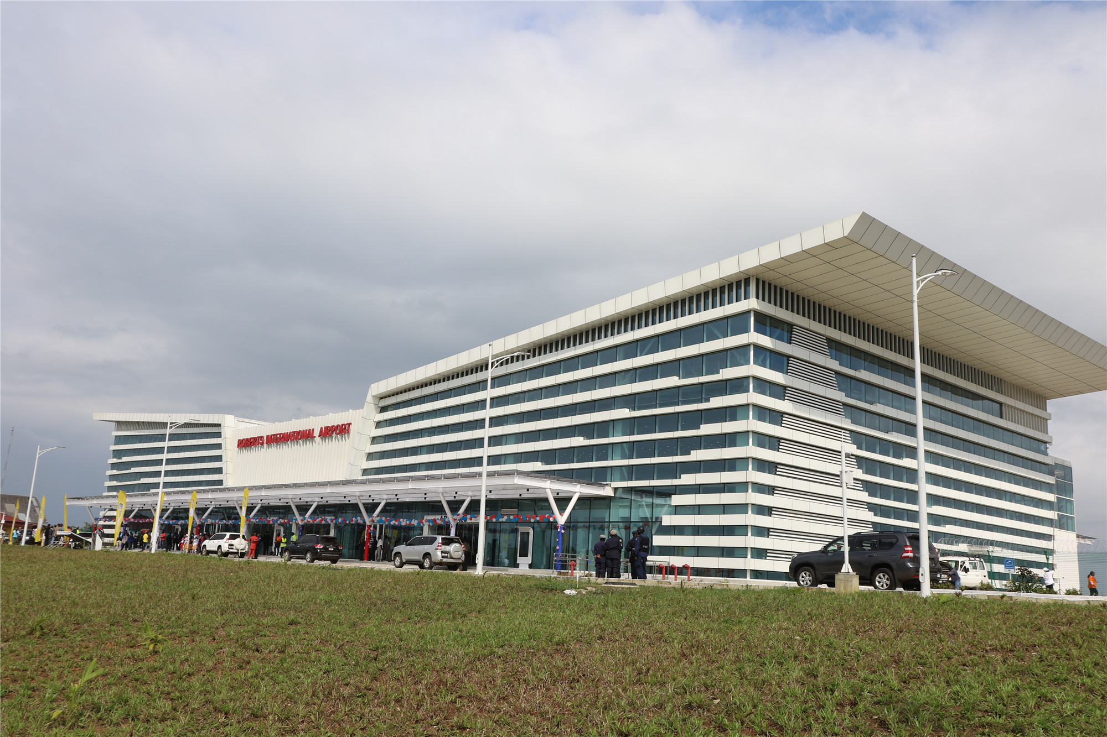
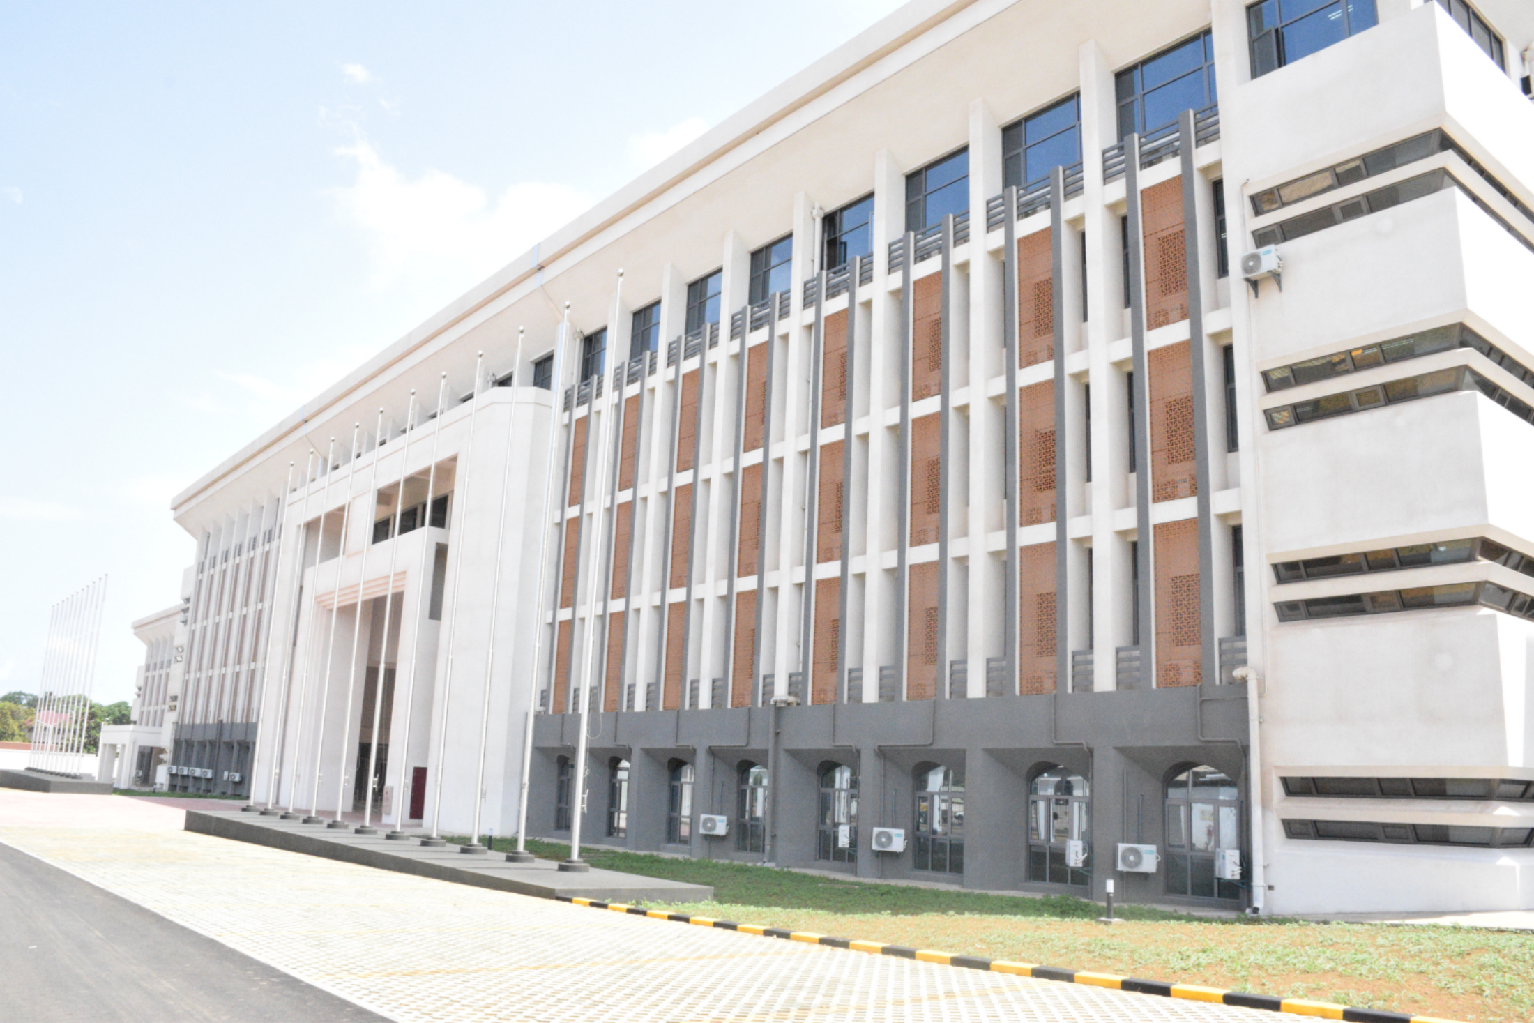
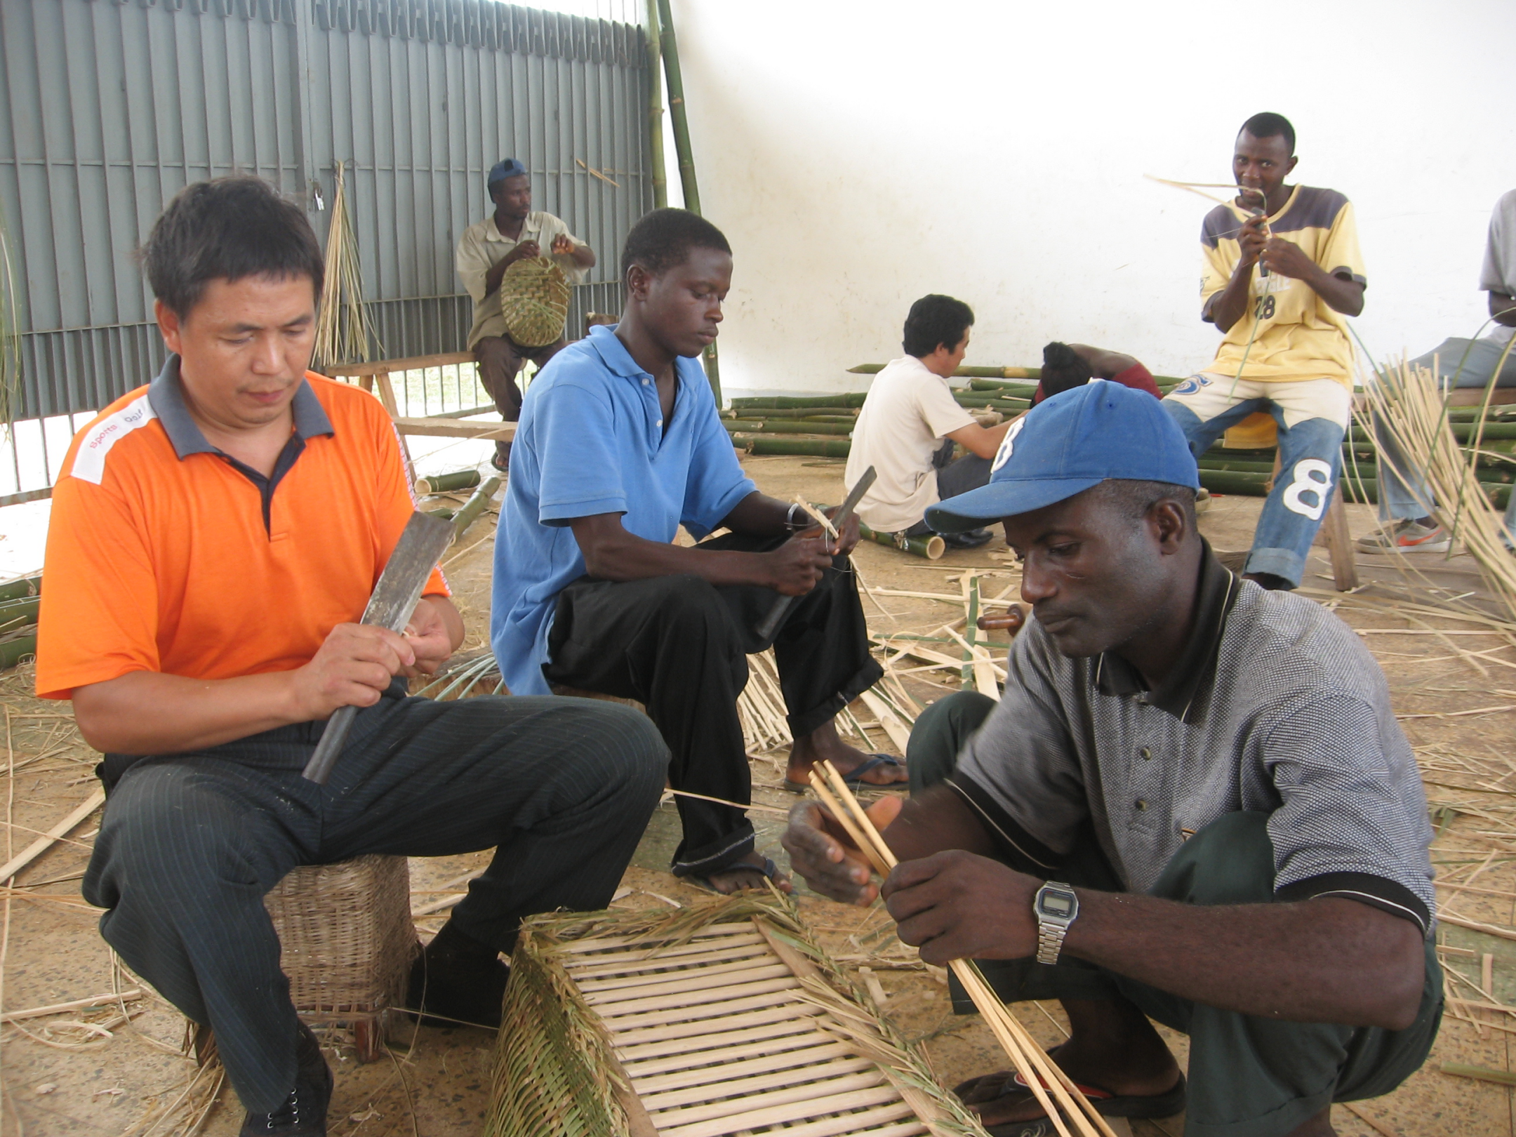

Slide 38
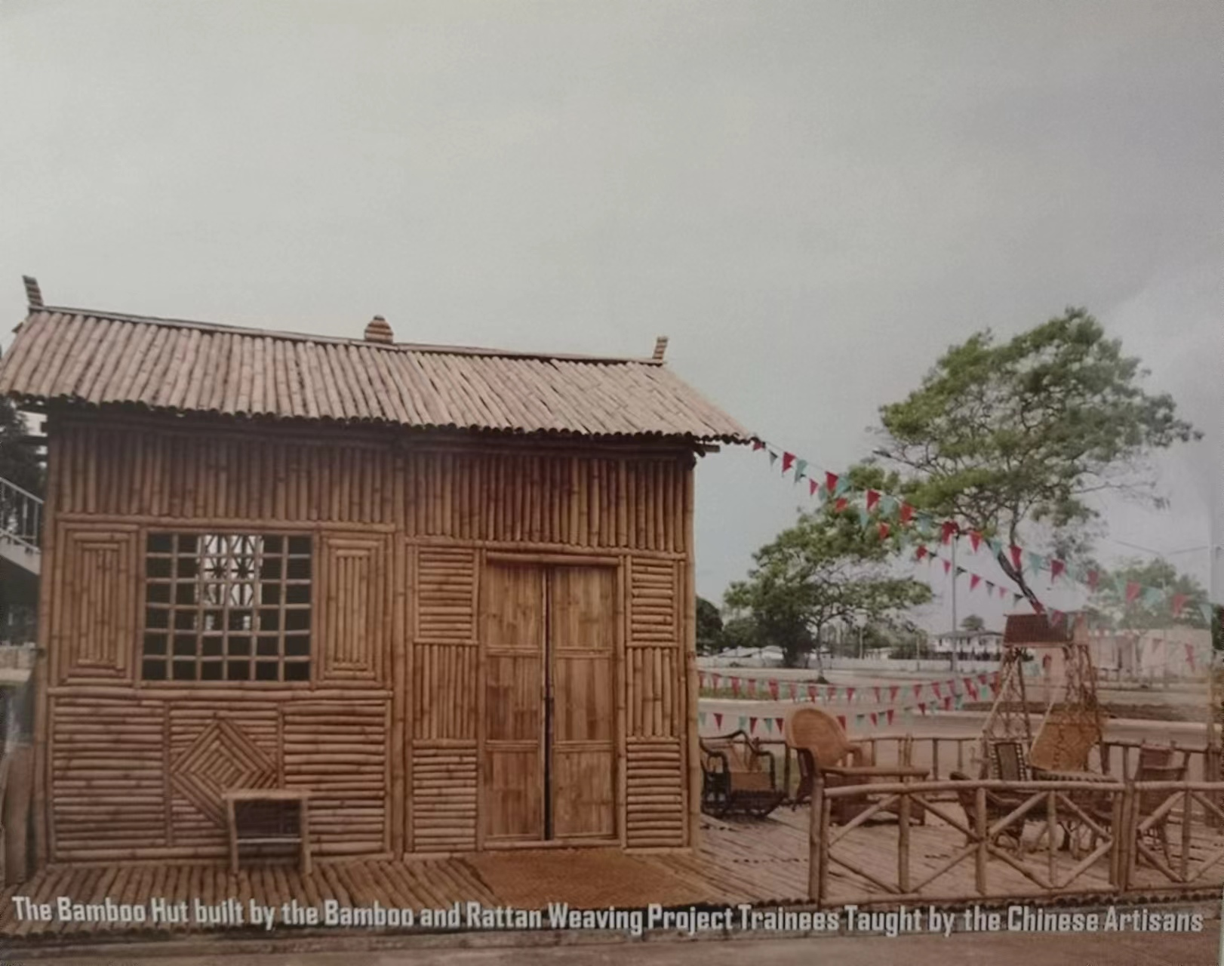

Slide 39
谢 谢 ！
THANK YOU!

